Slide 1

ProtecTalk – Business Model Canvas

Slide 2

Value Proposition
Protecting those most at risk—giving vulnerable individuals the confidence to live their daily lives without fear of financial fraud, and bringing peace of mind to the families.

Slide 3



Market Opportunity
17% → 59M+
people over the age of 65
334M+ Citizens
(U.S. Census Bureau, 2023)

Slide 4
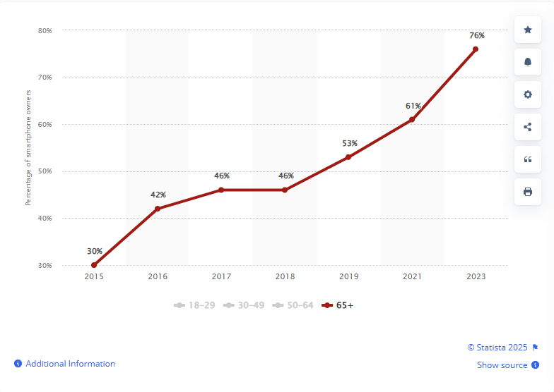


Market Opportunity
Smartphone ownership in the U.S. 2015-2023
Total Available Market (TAM)
44M+
Potential
Users
Adoption Rate
Approach | Uptake
Optimistic Projection | 3% → 1.3M
Realistic Market Estimate | 1.5% → 660K
Conservative Penetration | 0.5% → 220K

Slide 5
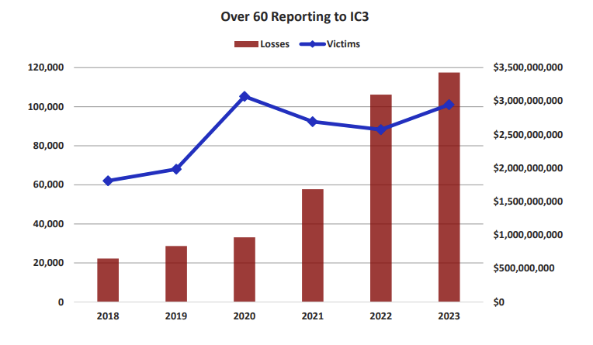



Fraud Impact
(FBI Elder Fraud Report, 2023)
Over $3 billion has been lost to scams affecting individuals over the age of 60
Nearly $770 million has been lost to call center fraud
On average, over $36,000 is lost per complaint
*Total reported losses from various types of scams
Reference Slide

Slide 6
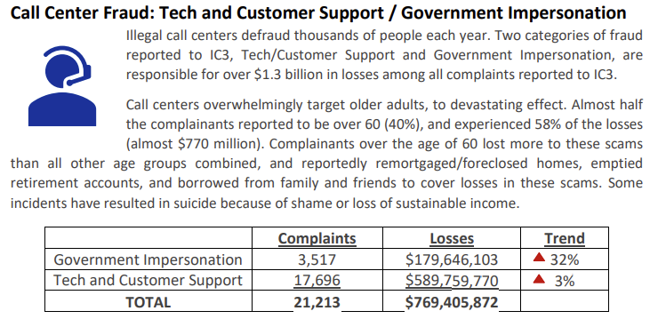

Fraud Impact

Slide 7
MVP Description
AI-Powered Scam Detection
Utilizes a remote AI model’s API to analyze incoming calls in real-time, identifying scam-like text patterns and providing immediate alerts.
Visual and Haptic Alerting
Alerts the user (the vulnerable individual) and their trusted contacts through visual and haptic signals about potential scam calls. The visual alerts (for the user) are displayed as a traffic light system, with three colors indicating the likelihood of the scam.
User Feedback for Custom AI Model Development
Enables users to submit call data, contributing to the continuous development of a customized AI model tailored for more accurate future scam detection.

Slide 8
Business Model Overview – Partnership with Banks
Objective: Develop a cutting-edge fraud detection model based on real-time data, which banks can license to protect their customers and enhance fraud prevention.
Why Banks Will Partner:
High financial losses from fraud: Victims lose millions due to fraud and the banks are ultimately responsible for reimbursing victims, making fraud prevention essential.
Regulatory pressure: Banks are under increasing pressure to reduce fraud and improve customer protection, with penalties for failing to do so.
Enhancing customer’s trust: By integrating ProtecTalk’s technology, banks can enhance security and trust for their customers, improving overall satisfaction and loyalty.
Data-driven insights: Banks are eager to leverage data-driven solutions to more accurately identify and prevent fraudulent activities.

Slide 9
Business Model – Revenue Model & Forecast
Revenue Model:
Phase 1 (Year 1):
Offer technology to 1,000 users for free or at a low cost to gather data.
Use this data to refine the fraud detection model.
Phase 2 (Year 2-3):
Once the model is proven effective, license the technology to 1-5 banks as a white-label solution.
Market Justification:
Data-driven insights will make the model highly attractive to banks once refined.
Similar models (e.g., Darktrace, Crowdstrike) show the success of data-driven, white-label technology in the financial sector.
Projected Revenue:
Year 1: Data collection, minimal revenue.
Year 2: Early licensing to 1-5 banks – $1M.
Year 3: Full-scale licensing to 30+ banks (world-wide) – $5M.

Slide 10
WBS
ProtecTalk
1. Foundation & Research
3. Fundraising
4. Company Incorporation
2. MVP
1.1. Conduct Market Research
1.2. Create Business Plan
1.3. Find Potential Customers
2.1. Define MVP Requirements
2.3. Write MVP Code
2.2. Buy Cloud Services
5. Post-MVP Expansion
3.1. Identify & Research Investors
3.2. Create Pitch Deck
3.3. Meet with Investors & Negotiate Terms
4.1. Sign Founder's Agreement
4.3. Open Business Bank Account
4.4. Choose Office Location & Sign Lease
4.5. Buy Computers & Essential Software
4.6. Set Up Workstations & IT Infrastructure
4.2. Register Business
5.1. Scale Product & Improve Features
5.1.1. Analyze User Feedback & Define Improvements
5.2. Marketing & Customer Acquisition
5.2.1. Require the ProtecTalk domain
5.1.2. Develop & Test New Features
5.1.3. Launch Feature Updates & Track Adoption
5.1.4. Hire Developers & Designers
5.2.2. Develop Branding & Website
5.2.3. Run Google & Facebook Ads
5.2.4. Launch Targeted Marketing Campaign
2.4. Test and Refine MVP

Slide 11
Gantt

Slide 12
Project Timeline
7 April 2025 – Signed Founders Agreement
9 April 2025 – Business Plan Ready
1 June 2025 – MVP Demo Ready
10 June 2025 – Pitch Deck Ready
29 August 2025 – Initial Funding Secured
9 September 2025 – Beta Version Ready
31 March 2026 – Reached 1,000 Users

Slide 13
Funding Request for Project
We request a total of 110,000$
Budget Breakdown

Slide 14
Budget Breakdown
Activities | Apr 2025 | May 2025 | Jun 2025 | Jul 2025 | Aug 2025 | Sep 2025 | Oct 2025 | Nov 2025 | Dec 2025 | Jan 2026 | Feb 2026 | Mar 2026 | Total per Expense
Founders’ Agreement Legal Fees | $850.00 |  |  |  |  |  |  |  |  |  |  |  | $850.00
Business Registration | $660.00 |  |  |  |  |  |  |  |  |  |  |  | $660.00
Trademark & IP Protection (+Attorney’s Fees) |  | $1,400.00 |  |  |  |  |  |  |  |  |  |  | $1,400.00
Accounting & Bookkeeping Tools | $140.00 | $140.00 | $140.00 | $140.00 | $140.00 | $140.00 | $140.00 | $140.00 | $140.00 | $140.00 | $140.00 | $140.00 | $1,680.00
Cloud Services (AWS/GCP/Azure) | $130.00 | $130.00 | $130.00 | $160.00 | $190.00 | $400.00 | $700.00 | $700.00 | $900.00 | $900.00 | $1,500.00 | $1,600.00 | $7,440.00
Domain Purchase & Annual Fee | $20.00 |  |  |  |  |  |  |  |  |  |  |  | $20.00
Essential Software Licenses (IDE, Figma, Mondey.com etc.) |  | $250.00 | $250.00 | $250.00 | $250.00 | $250.00 | $250.00 | $250.00 | $250.00 | $300.00 | $300.00 | $300.00 | $2,900.00
Market Research Tools & Surveys (+Data Acquisition) | $305.00 |  |  |  |  |  |  |  |  |  |  |  | $305.00
Brand Development (Logo, Design) |  |  | $400.00 |  |  |  | $1,800.00 |  |  |  |  |  | $2,200.00
Website Hosting & Development Tools |  |  | $556.00 | $28.00 | $28.00 | $28.00 | $28.00 | $28.00 | $28.00 | $28.00 | $28.00 | $28.00 | $808.00
Google & Facebook Ads |  |  |  | $300.00 | $300.00 | $300.00 | $300.00 | $300.00 | $400.00 | $400.00 | $400.00 | $800.00 | $3,500.00
Public Relations & Outreach Tools (Influencers) |  |  |  | $139.00 | $139.00 | $139.00 | $139.00 | $139.00 | $139.00 | $139.00 | $139.00 | $139.00 | $1,251.00
Customer Onboarding Tools (Chat, CRM) |  |  |  |  |  | $150.00 | $150.00 | $260.00 | $260.00 | $260.00 | $260.00 | $260.00 | $1,600.00
Computers & Equipment |  | $10,000.00 |  |  |  |  |  | $7,000.00 |  |  |  |  | $17,000.00
Utilities & Internet (Shared Costs) |  | $60.00 | $60.00 | $60.00 | $60.00 | $60.00 | $60.00 | $60.00 | $60.00 | $60.00 | $60.00 | $60.00 | $660.00
Bank Account Fees | $25.00 | $25.00 | $25.00 | $25.00 | $25.00 | $25.00 | $25.00 | $25.00 | $25.00 | $25.00 | $25.00 | $25.00 | $300.00
Insurance (Basic Business Insurance) | $40.00 | $40.00 | $40.00 | $40.00 | $40.00 | $40.00 | $40.00 | $40.00 | $40.00 | $40.00 | $40.00 | $40.00 | $480.00
AI Expert (Part-Time) |  |  |  |  |  |  |  | $4,000.00 | $4,000.00 | $4,000.00 | $4,000.00 | $4,000.00 | $20,000.00
Advertising Specialist |  |  |  |  |  |  |  | $1,000.00 | $1,000.00 | $1,000.00 | $1,000.00 | $1,000.00 | $5,000.00
Cyber Expert(Part-Time) |  |  |  |  |  |  |  | $4,000.00 | $4,000.00 | $4,000.00 | $4,000.00 | $4,000.00 | $20,000.00
Contingency Fund | $150.00 | $150.00 | $150.00 | $150.00 | $150.00 | $250.00 | $250.00 | $250.00 | $250.00 | $250.00 | $300.00 | $300.00 | $2,600.00
Renting Fees (Office, Electricity and Water) |  |  |  |  |  |  | $3,000.00 | $3,000.00 | $3,000.00 | $3,000.00 | $3,000.00 | $3,000.00 | $18,000.00
Total Monthly Expenses | $2,320.00 | $12,195.00 | $1,751.00 | $1,292.00 | $1,322.00 | $1,782.00 | $6,882.00 | $21,192.00 | $14,492.00 | $14,542.00 | $15,192.00 | $15,692.00 | $108,654.00

